Slide 1
Machine Learning Capstone: Date-A-Scientist
Machine Learning Fundamentals
Erin Howe
12/10/2018

Slide 2
Table of Contents
Data Exploration
Data Visualization
Question
Data Augmentation
Data Classification
Data Regression
Conclusions

Slide 3
Data Exploration
For data exploration, I examined the entire table using .head(). I also examined some specific columns and their properties, such as:
.head()
.isnull().values.any()
.describe()
.unique()
Columns:
Body_type
Height
Drinks
diet

Slide 4
Data Visualization

Slide 5
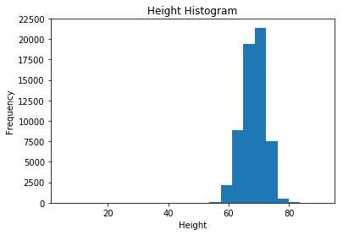
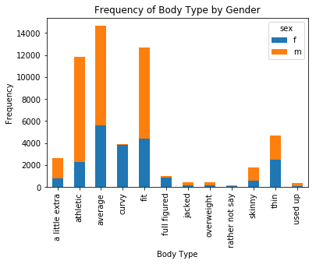
Height and Body Type Distributions
I used a histogram to visualize the distribution of height, with 25 bins and a range of 1 to 95. I used a stacked bar graph to visualize the distribution of body type in each of the categories, grouped by gender.

Slide 6
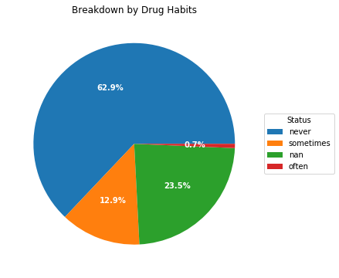
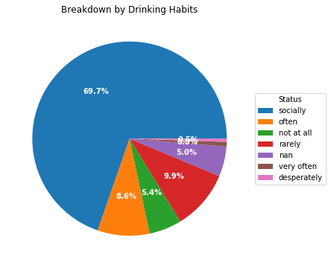
Drinking and Drug Habits Visualization
To visualize the proportion of each category of drug habit and drinking habit, I created two pie charts. I found this was a good way to see the proportions and how they relate to each other. It can be seen that a vast majority of users report never using drugs and only socially drinking. There was also a large proportion of non-responses for drug habits.

Slide 7
Question:
Can we predict body type based on diet, drinking habits, drug habits, height, and gender?

Slide 8
Data Augmentation
Body Type Category | Body Type Code
Rather Not Say | 0
Overweight | 1
Full Figured | 2
A Little Extra | 3
Curvy | 4
Average | 5
Thin | 6
Skinny | 7
Athletic | 8
Fit | 9
Jacked | 10
Used Up | 11
In order to use most of the variables I selected, I had to create new columns to show the data numerically, rather than categorically. New columns were created using .map() for [body_type], [diet], [drink], [drugs], and [sex]. I also used train_test_split() to create training and test datasets and labels.
Notes:
body_type_mapping = {'rather not say':0, 'overweight':1, 'full figured':2, 'a little extra':3, 'curvy':4, 'average':5,
'thin':6, 'skinny':7, 'athletic':8, 'fit':9, 'jacked':10,'used up':11}

Slide 9
Data Classification

Slide 10
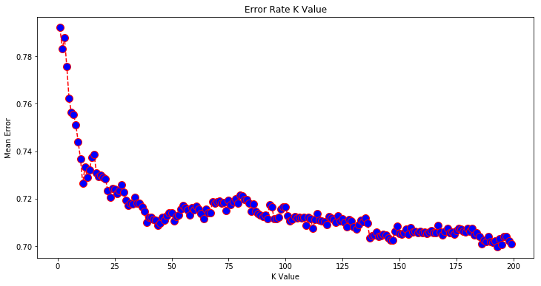
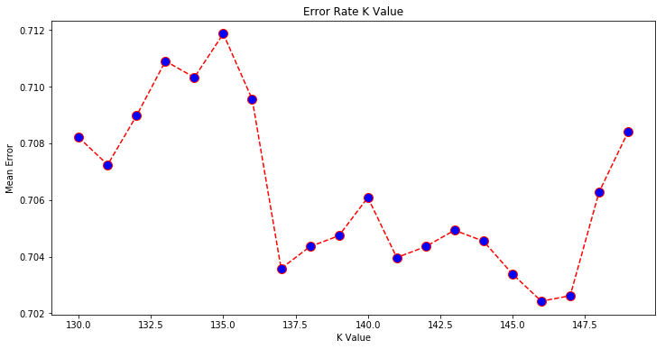
K Nearest Neighbors Classification
Using the training dataset and labels, I fit a K Nearest Neighbors Classifier using 146 neighbors. I came to this number of neighbors after plotting values of K against the mean error for k between 1 and 200. The classification was not very accurate and only had a score of 0.2976. The model did not perform will with precision, recall, or f1-score.

Slide 11
SVC Classification
Gamma Value | Classification Score
17 | 0.2937211
18 | 0.2933359
19 | 0.2939137
20 | 0.2933359
21 | 0.2929597
I also attempted to use SVC Classification on the training dataset. I used an RBF kernel with a gamma value of 19. This gamma value was found by running multiple values and using the one that had the largest score. This classification method did not perform much better, and only had a score of 0.2939. The model did not perform will with precision, recall, or f1-score.

Slide 12
Data Regression

Slide 13
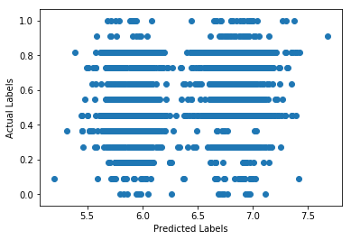
Multiple Linear Regression
Using the training dataset, I fit a multiple linear regression. This method did not perform well and only had an R² value of 0.0503.

Slide 14
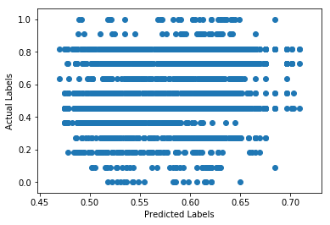
K Nearest Neighbors Regression
I performed the K Nearest Neighbors Regression on the training dataset using the same number of neighbors that I used for the K Nearest Neighbors Classification. This regression also had a low R² value of only 0.0546.

Slide 15
Conclusions
Ultimately, neither classification techniques nor regression techniques worked well using these variables. Moving forward, we could change which variables were used to predict body type.
Both classification models only had about a 30% correctness in classifying individuals by body type, which is not a very accurate model.
Both regression models had an R² value of about 0.05, which is not much of a correlation between the variables and the label.

